Slide 1

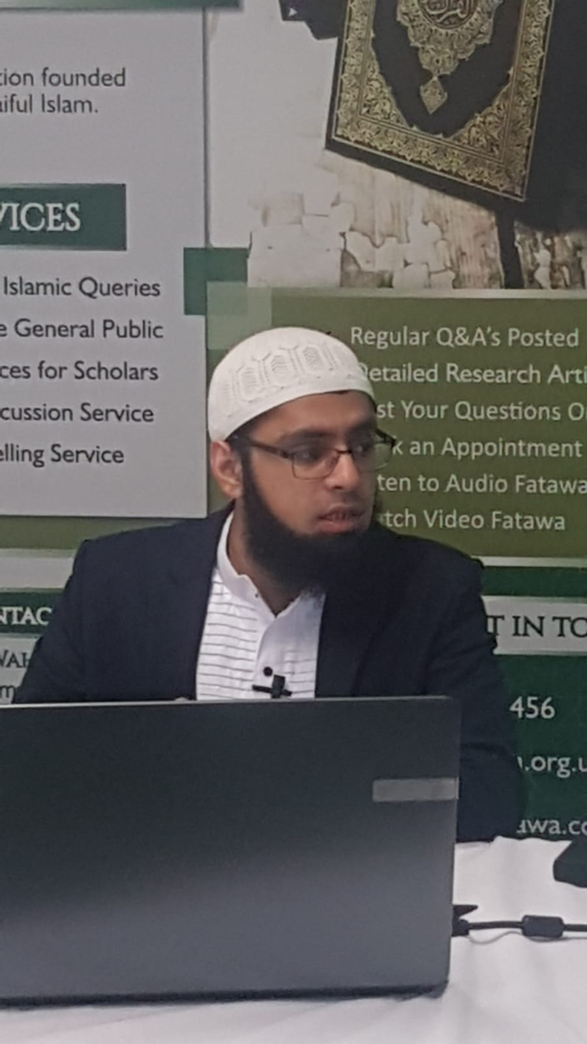
The Fiqh of Ramadhān Fast
By Mufti Abdul Waheed
Date: Sunday 4-4-21
e: fatawa@jkn.org.uk
Twitter: @AbdulAwm786
Facebook: JKN Fatawa & Abdul Waheed Muhammad
W: jknfatawa.co.uk
© Mufti Abdul Waheed – All rights reserved

Slide 2
Introduction
The purpose of Fasting and its meaning.
Principles related to invalidation of Fast
Kaffarah (penalty) and Qadha.
Concessions around the permissibility to break or postpone one’s Fast.
Some Common Questions

Slide 3
Short Exercise
Based on your previous knowledge, what does fasting mean, what is its purpose and why should we study it? (10mins discussion)

Slide 4
The Holy Quran and Fasting
يَا أَيُّهَا الَّذِينَ آمَنُوا كُتِبَ عَلَيْكُمُ الصِّيَامُ كَمَا كُتِبَ عَلَى الَّذِينَ مِنْ قَبْلِكُمْ لَعَلَّكُمْ تَتَّقُونَ
O believers! Fasting is prescribed for you as it was prescribed for those before you so that you may attain TAQWA (Surah al-Baqara:183)
أَيَّامًا مَعْدُودَاتٍ ۚ فَمَنْ كَانَ مِنْكُمْ مَرِيضًا أَوْ عَلَىٰ سَفَرٍ فَعِدَّةٌ مِنْ أَيَّامٍ أُخَرَ ۚ وَعَلَى الَّذِينَ يُطِيقُونَهُ فِدْيَةٌ طَعَامُ مِسْكِينٍ ۖ فَمَنْ تَطَوَّعَ خَيْرًا فَهُوَ خَيْرٌ لَهُ ۚ وَأَنْ تَصُومُوا خَيْرٌ لَكُمْ ۖ إِنْ كُنْتُمْ تَعْلَمُونَ
Fast the prescribed number of days; except if any of you is ill or on a journey, let him fast a similar number of days later. For those who can not endure it for medical reasons, there is a ransom: the feeding of one poor person for each missed day. But if he feeds more of his own free will, it is better for him. However, if you truly understand the rationale of fasting, it is better for you to fast. (Surah al-Baqara:183)

Slide 5
شَهْرُ رَمَضَانَ الَّذِيَ أُنزِلَ فِيهِ الْقُرْآنُ هُدًى لِّلنَّاسِ وَبَيِّنَاتٍ مِّنَ الْهُدَى وَالْفُرْقَانِ فَمَن شَهِدَ مِنكُمُ الشَّهْرَ فَلْيَصُمْهُ وَمَن كَانَ مَرِيضًا أَوْ عَلَى سَفَرٍ فَعِدَّةٌ مِّنْ أَيَّامٍ أُخَرَ يُرِيدُ اللّهُ بِكُمُ الْيُسْرَ وَلاَ يُرِيدُ بِكُمُ الْعُسْرَ وَلِتُكْمِلُواْ الْعِدَّةَ وَلِتُكَبِّرُواْ اللّهَ عَلَى مَا هَدَاكُمْ وَلَعَلَّكُمْ تَشْكُرُونَ
It is the month of Ramadhan in which the Qur'an was revealed, a guidance for mankind with clear teachings showing the Right Way and a criterion of truth and falsehood. Therefore, anyone of you who witnesses that month should fast therein, and whoever is ill or upon a journey shall fast a similar number of days later on. Allah intends your well-being and does not want to put you to hardship. He wants you to complete the prescribed period so that you should glorify His Greatness and render thanks to Him for giving you guidance. (Surah al-Baqara:185)

Slide 6
What is the Fiqh of Fasting
Fiqh means a deep understanding of something with its correct application
Fiqh of Fasting means understanding the legal injunctions pertaining to Fasting and their correct application.

Slide 7
Why Study the Fiqh of Fasting?
To attain spiritual healing
To ensure that our Fast is valid and accepted by Allāh.
It is mandatory for the Mukallaf (legally commissioned person) to acquire knowledge of his/he Faraidh (obligations).
Helps us to understand the real meaning and correct manner of Fasting.

Slide 8
Definition of Fasting
Imām Qudoori (ra) has defined Fasting as;
“Fasting is to refrain from eating, drinking and intimate relationship during the day (from the crack of dawn up until sunset) with the intention made.” (p. 52)

Slide 9
Niyyah - Intention
Niyyah literally means the knotting of the heart. In the technical sense, it means to make a firm intention before practicing an Ibādah in order to draw closeness to Allāh.
Niyyah can be made until just before Zawal time (zuhr) provided that one hasn’t eaten after subh Sadiq.
NB: Niyyat is Fardh. An Ibādah is rendered meaningless without Niyyah.

Slide 10
Types of Fast
Nafil
Stipulated Fasts
Non-Stipulated Fasts
Qadha
Kaffarah
Non-fixed Vows
Ramadhān
Sunnah Fasts
Fixed vows
Intention by night or before midday (Zawal) is Necessary
Intention by night is Necessary

Slide 11
Upon whom is Fasting Obligatory?
The following pre-requisites obligate Fasting upon a person:
Muslim
Sane
Buloogh
Fit and healthy

Slide 12
The Five Golden Principles
Qualified Cavity
Relates to what area the food or agent reaches.
Qualified Passage
Pathway that leads to any of the above qualified cavity.
Throat, stomach, intestines. If food/agent reaches these 3 areas the fast is broken.
Mouth and nose lead to the throat Anus/rectum lead to the intestines.
Abdominal injury leads to the stomach

Slide 13
Qualified Agent
The food/agent is of a nourishing source or not.
Inhaling smoke intentionally, Intentionally swallowing a bead, stone etc, Intentionally inhaling avoidable substances break the fast.
Qualified consequences
The settling and absorption of the food/agent. Hence, anything inserted into the throat and immediately drawn out does not break the fast provided no remnant of it remains.

Slide 14
Qualified Excuses
The following not excused: Necessity, ignorance, accident, coercion, sleep (unconsciousness). Only Qadha is necessary.
Don’t invalidate the fast despite of the above points; Forgetfulness, Arduousness (i.e. fumes, vapour, dust, saliva, mucus)

Slide 15
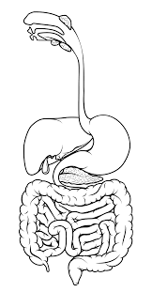
Qualified Agent - food
Qualified Passage – Mouth and nose
Qualified Cavity - Throat
Qualified Cavity – stomach in which the agent settles
Qualified Cavity - intestines
Qualified Passage – Anus/rectum

Slide 16
Short Exercise
Using the above principles, explain whether the following should break the fast or not.
Glucose drip
Asthma pump
Endoscopy
Suppository
Smear test
Passive smoking

Slide 17
2 Types of Rulings of Invalidation
That which Necessitates both Qadha and Kaffarah
That which Necessitates Qadha only.
Kaffarah is a penalty a person must give as a expiation for the crime
Qadha means to make up the number of Fasts missed
Kaffarah becomes necessary if;
Someone intentionally eats or drinks that which is naturally nourishing.
Someone intentionally has intimate relationship in the vaginal or the anal passage with or without ejaculation.
Someone intentionally drink medication without necessity
All of the above are considered a crime which necessitate a penalty.

Slide 18
What is the Penalty?
To emancipate a slave (NOT APPLICABLE TODAY),
To Fast for 60 days, BUT if unable to do so then,
To feed 60 poor and destitute people;
i) They should be poor enough that they are eligible for Zakāt also.
ii) One must give each poor person the equivalent amount of Sadqatul-Fitr, or feed him two meals a day.
iii) It is also permissible to feed one poor person two meals per daily for sixty days, or to give the value of Sadqatul-Fitr each day for sixty days.
Note: To feed one poor person in one day two meals equivalent to sixty days will class will only count towards one day only.

Slide 19
Invalidators of Fast
Those factors Necessitating Qadha only
To intentionally eat or drink something which is not naturally nourishing.
Ejaculation through physical touching but without actual intercourse e.g. Masturbation, caressing with one’s spouse etc.
To intake medication due to a genuine reason.
To eat or drink accidently
To eat deliberately after eating, drinking, vomiting unintentionally or having intercourse out of forgetfulness assuming that the Fast broke.

Slide 20
A person eats assuming that suhoor has not ended or iftar has begun but the reality was the contrary.
To intentionally allow (or inhale) smoke or dust to enter the mouth.
To intake smoke into the nostrils intentionally
A Fasting person who becomes unconscious for a few days then apart from the first day, the remaining days he must do Qadha.
To intentionally vomit a mouthful.
To intentionally return the vomit back onto the stomach, whether small quantity or large.

Slide 21
Non-Invalidators of the Fast
To eat, drink or have intimate relationship forgetfully.
To ejaculate whilst having a wet dream
To apply oil or surma
Smoke to enter the mouth unintentionally.
Vomiting unintentionally even a mouthful.
To swallow something stuck between your teeth that is less than a chickpea in quantity.
Injection or anything that enters the brain or stomach not through its normal channel.
Cupping
Wet dream
Ear drops
Inserting something into the vaginal tracts

Slide 22
Concession of Invalidating the Fast
A person who is suffering from severe illness or the illness is surely to increase.
Extreme hunger risking the life or health.
A traveller who feels genuine constrain if he continues to Fast.
A pregnant woman fearing for her child
A breast feeding woman

Slide 23
Those Exempted from Fasting
An ill person who fears the deterioration of his state if he Fasts.
A frail person- in which case he must pay fidya
A pregnant woman
A breastfeeding woman.
Traveller
A menstruating woman
A woman having post-natal bleeding

Slide 24
Principles of Illness
Worsening Physical Condition
Slower
Recovery
Worsening Mental Condition
Worsening
Pain
Valid reasons for an ill person not to fast or break the fast

Slide 25
Exercise
Determine whether the following are exempted from fasting or not.
A person suffering from sever migraine
Someone suffering severe tooth ache who needs to take paracetamol.
Young man with mild back pain.
Someone suffering from chronic depression.
A madrasah student attending classes during Ramadhan

Slide 26
Case study - Sisters
Zahida started her menses a few days before Ramadhān. Here bleeding habit 8 days. She finishes her periods on the third day of Ramadhān around 8am.
Can she fast during the day by making the intention?
Based on your answer must she abstain from eating and drinking throughout the day or not?
Supposedly she finished around 2pm then is the ruling the same?

Slide 27
Case Study
There is a person who will be travelling for Umrah during the last ten days of Ramadhān. He started fasting however due to the intense heat and long distance travelling, he is thinking of breaking his fast and make up for it later.
If he made the intention, can he break his fast?
If he does, would Kaffarah also be necessary?

Slide 28
Some rules pertaining to Fidya
A person who is terminally ill [lifelong] or extremely frail and unable to Fast at any point in their life then they must pay fidya for every Fast in the month of Ramadhan. The amount of fidya is equivalent to Sadqatul-Fitr which should be given the poor and destitute person.
Note: One fidya compensates for each day of the Ramadhān Fast
If someone pays more than a day’s worth of fidya to a single poor person (on that same day) then it shall not suffice according to Imām Abū Haneefah whilst other scholars allow it. (Ibn Ābideen Shāmi p.427 vol 2)

Slide 29
Miscellaneous
Disliked acts of Fasting
To chew something unnecessarily without swallowing it.
Using toothpaste.
To kiss or come into contact with one’s spouse without self-control.
Gathering saliva to quench the thirst
To do anything that weakens the person.

Slide 30
Mustahab acts of Fasting
To take part in Suhoor – to delay it towards its end time.
To take part in Iftar instantly.

Slide 31
Taraweeh is Twenty Rak’ats
“The people of knowledge have differed concerning the number of Rak’āts of Tarāweeh performed during Ramadhān. Some have asserted to be forty-one Rak’āts including the Witr. This was the opinion of the people of Madeenah and their practice. However the opinion of the majority is twenty Rak’āts of Tarāweeh and this opinion is in line of the narrations of Sayyidunā Ali , Sayyidunā Umar and other companions. This is also the opinion of Sufyān at-Thawri, Abdullāh Ibn Mubārak and Imām Shāfi’ee. In fact, Imām Shāfi’ee states, ‘I found the people of my city, Makkāh performing twenty Rak’āts.’ Imām Ahmad v states, ’There are various reports to be found concerning Tarāweeh but no exact number to be confirmed.’ Ishāq states, ’We performed forty-one Rak’āts according to the narration of Sayidunā Ubay Ibn Ka’b.” (Tirmizi)
Ibn Rushd states,
“Imām Mālik (in one opinion) along with Imām Abu Haneefah, Imām Shāfi’ee , Imām Ahmad and Dāwood az-Zāhiri prefer twenty Rak’āts to be performed in Ramadhān excluding the Witr. Ibnul Qāsim reports from Imām Mālik that he preferred thirty-six Rak’āts with three witr.” (Bidāyatul Mujtahid)

Slide 32
General Rules about Taraweeh
Taraweeh is Sunnatul-Mu’akkadah consisting of twenty rak’ats. It can be read in two units or four units.
It must be read after the Esha Salāh – without Esha Salāh Taraweeh is invalid.
If someone arrived late to the masjid where the Imam has started the Taraweeh Salāh then one must primarily perform the Esha Salāh and then Join the Imam. Whatever rak’ats have been missed can be read after the Witr Salāh.
Women are encouraged to pray their Taraweeh at home individually.
As long as Jamat in the Masjid is taking place, it is permissible for some individuals to pray at home in congregation, as it is the Jama’ah that is Sunnah. If the women family members join the congregation then it is permitted. It would be permissible to stand a meter or so apart due to COVID restrictions.
One should NOT pray Taraweeh whilst standing without a valid reason. Valid reason include extreme tiredness due to old age, pain in the leg, illness, injury etc.

Slide 33
Case study
Zaid for instance is praying Taraweeh at home behind his Hafiz son. He initially prays whilst standing in the first rak’at but due to the length of the rak’at and his son’s slow recitation, he begins to feel pain in his back and legs and so decides to sit down throughout the remainder of the two rakats.
Is his Taraweeh valid?
What if his pain was not so severe then would his Taraweeh be valid considering that he is old, is it still valid?

Slide 34
Rules of I’tikāf
I’tik āf means to seclude oneself in the Masjid. There are four condition for I’tikāf to be valid;
a) To remain in the Masjid
b) To make the intention of I’tikāf
c) To be pure from major impurity e.g. Janabat.
d) To Fast
There are three types of I’tikāf;
a) Wajib b) Sunnat-e-Mu’akkadah c) Nafil

Slide 35
What invalidates the I’tikāf
To leave the Masjid without a valid reason even for a slight moment. Valid excuse could be;
Fardh Ghusl or to answer the call of nature
There is a potential threat in staying in the masjid
To acquire food if no one is available to deliver him food.

Slide 36
Most Common Questions
Q1: If a person intends to travel abroad during mid-day, can he break his Fast before travelling?
A: No it is not permissible as he is still a resident. If he does then both Qadha & kaffarah become necessary.
Note: If a Musafir breaks his Fast deliberately then only Qadha is necessary. He can simply choose not to fast altogether and make up for it later.

Slide 37
Q2: If someone deliberately broke multiple Fasts in the same Ramadhān then does this necessitate multiple Kaffarahs as well?
A: No. Only one Kaffarah is sufficient. The similar case would be if he broke multiple Fasts in two Ramadhān without paying a Kaffarah in between.
Q3: When the Adhan is called out for Suhoor whilst the food is in one’s mouth then must he discard it immediately?
A: No, he is not required to discard it. It is permissible to finish off the remaining few morsels but not to begin eating at that time.
Note: One must be always conscious of the end time of Suhoor. It is recommended to stop eating a few minutes before the end time of suhoor.

Slide 38
Q4: Does drawing blood out invalidate the Fast?
A: No, it does not invalidate the Fast.
Q5: Am I allowed to visit the dentist to take my tooth out whilst Fasting?
A: Yes. The breaking of the Fast relates to anything that slips down the throat and reaches the stomach. As long as one is assured that nothing will slip down the throat, you can visit the dentist.
Q6: If I miss suhoor then can I still fast?
A: Yes you can by making the intention so long as it is before Zawal time (Zuhr).

Slide 39
Q&A

